Slide 1

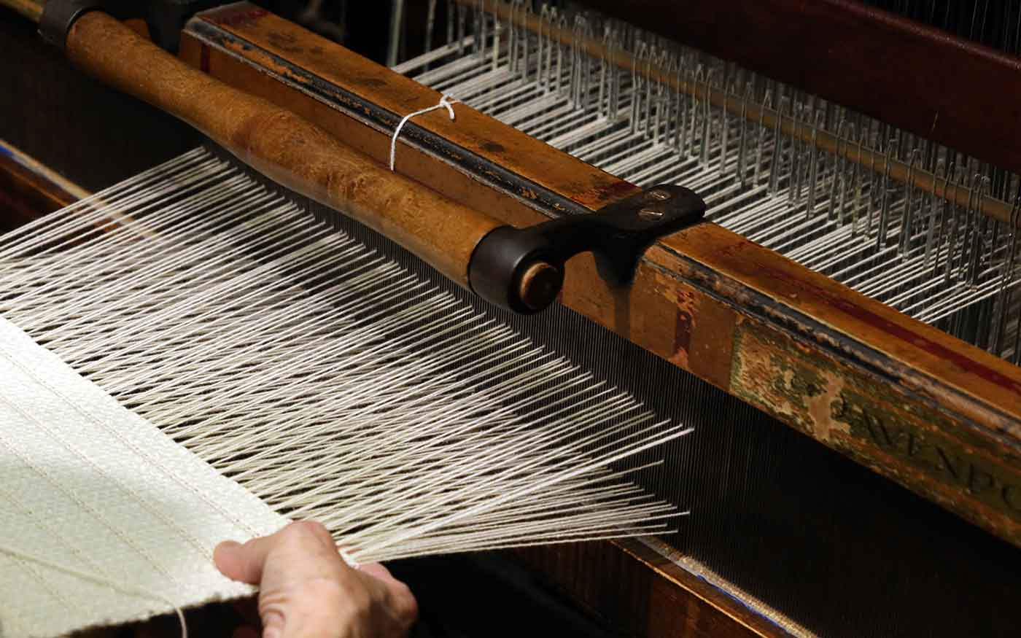
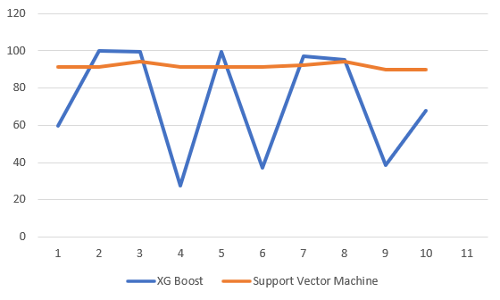
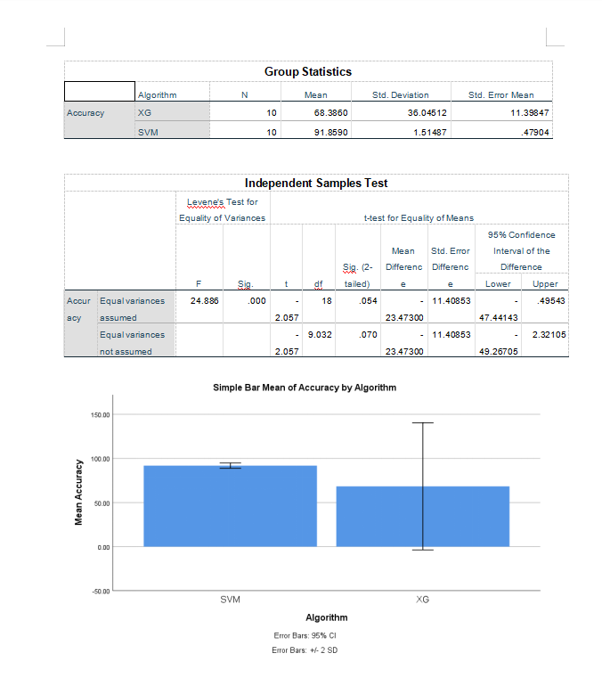
Name : S .Ashish Kumar
Register number:192124142
Guided by : Dr . A .Muniyappan
Optimizing Textile Production Forecasting :A Comparative Study Of XG Boost And Support Vector Machine.
INTRODUCTION
Textile production forecasting is crucial for optimizing manufacturing processes in response to market demands.
Machine learning techniques offer promising avenues for enhancing predictive modeling in textile production.
XG Boost and SVM represent contrasting yet powerful machine learning methodologies suitable for this task.
Two groups were analyzed in this research.
Group 1: XGBoost Algorithm,
Group 2: Support Vector Machine.
The selection of an apt machine learning model emerges as a pivotal determinant in realizing accurate and dependable forecasts amid the nuanced dynamics of production variables.
Textile production represents a multifaceted realm, characterized by a myriad of interwoven variables spanning from raw material compositions to intricate manufacturing parameters, all culminating in the final product output.
This study embarks on an exploration into the domain of textile production forecasting.
implementation of an optimal machine learning model holds the promise of ushering in transformative shifts in industry practices, fostering efficiency gains, cost reductions, and mitigating environmental footprints.
Predicting Textile production
MATERIALS AND METHODS
Hyper-
Parameter
tuning
Raw Data
Data preprocessing
Data formatting
Data Transforming
Data Reducing
Data sampling
Training
Dataset
ML
Classification
Training
Model
Evaluation
Enriched
Data
Testing
Dataset
Model
Predictions
Validation Data
RESULTS
Algorithm statistics of XG Boost And Support Vector Machine
 | Group | N | Mean | Std. Deviation | Std. Error Mean
Accuracy | Support Vector Machine | 10 | 91.8590 | 36.04512 | 11.39847
 | XG Boost | 10 | 68.3860 | 1.51487 | 0.47904
First Accuracy Graph
XG Boost vs Support Vector Machine
It shows the accuracy of Support Vector Machine is 91.8590 and accuracy of XG Boost is 68.3860. X- axis denotes Support Vector Machine Vs XG Boost and Y-axis denotes mean accuracy, with error bars indicating ±2 SD.
DISCUSSION AND CONCLUSION
In the comparison between Support Vector Machine (SVM) and XGBoost algorithms, Support Vector Machine achieves an accuracy of 91.8590, while XGBoost achieves 68.3860 accuracy.
Linear Regression outperforms K-Nearest Neighbours (KNN) in accuracy, achieving 96.51%, while KNN achieves 87.502% accuracy.
The analysis indicates that KNN performs relatively worse than Linear Regression, with an accuracy of 87.502%.
T-test Statistical analysis reveals a significance value of p=0.001 (independent sample T-test p<0.05), signifying a statistically significant difference between the two groups.
This prompts reflection on the factors influencing algorithm performance in specific contexts, emphasizing the need for empirical validation of algorithmic choices.
Overall, Linear Regression demonstrates higher accuracy compared to KNN in a novel model for comprehensive financial analysis.
We used SPSS a data analysis of software made by IBM to perform analyzing on data obtained graph for both algorithms XG Boost and Support Vector Machine.
This finding underscores the importance of selecting the most appropriate algorithm for predictive tasks within the textile production domain.
The superior performance of Support Vector Machine suggests that simpler models may sometimes yield better results, emphasizing the significance of considering algorithm complexity alongside predictive accuracy.
BIBLIOGRAPHY
A. Hasanbeigi, “Energy-efficiency improvement opportunities for the textile industry,” Ernest Orlando Lawrence Berkeley National Laboratory,Berkeley, CA, Tech. Rep., 2010.
S. Wang, J. Wan, D. Li, and C. Zhang, “Implementing smart factory of industrie 4.0: An outlook,” International Journal of Distributed Sensor Networks, vol. 12, no. 1, pp. 158–168, 2016.
A.V.Prasad, &Krishna, ExploringtheConvergence of Big Data and the Internet of Things. Hershey, PA: IGI Global, 2017.
R. Buyya, J. Broberg, and A. M. Goscinski, Cloud computing: Principles and paradigms. Hoboken, NJ: John Wiley & Sons, 2010.
M. Dorgham, “Warping parameters influence on warp yarns properties: Part 2: Warp yarn material and cone position on warping creel,” Ph.D. dissertation, Weaving and Knitting Department Faculty of Applied Arts, Helwan University, Cairo, Egypt, 2014.
Mohammed A (2020) Towards ‘gresilient’ supply chain management: a quantitative study. Resour Conserv Recycl 155:104641.
Oliva R, Watson N (2009) Managing functional biases in organizational forecasts: a case study of consensus forecasting in supply chain planning. Prod Oper Manag 18(2):138–151.
Van der Laan E, van Dalen J, Rohrmoser M, Simpson R (2016) Demand forecasting and order planning for humanitarian logistics: an empirical assessment. J Oper Manag 45:114–122.

